Slide 1










1

Slide 2




HARLLYNNE | 2020
2

Slide 3




Slide 4





It helps in editing, publishing and modifying the content of the website.
4

Slide 5







Easier to use and a number of features you can utilize.
5

Slide 6


PROS & CONS
It is an open source platform and available for free. The original source code is made freely available and may be redistributed and modified.
CSS files can be modified according to the design as per users need.
There are many plugins and templates available for free.
Users can customize the various plugins as per their need.
6

Slide 7



PROS & CONS
It offers several SEO tools which makes on-site SEO simple.
It is very easy to edit the content as it uses WYSIWYG editor (What You See Is What You Get is a user interface that allows the user to directly manipulate the layout of document without having a layout command).
It allows creating different roles for users for website such as admin, author, editor and contributor.
7

Slide 8



PROS & CONS
Using several plugins can make the website heavy to load and run.
Sometimes software needs to be updated to keep the WordPress up-to-date with the current browsers and mobile devices.
Updating WordPress version
leads to loss of data, so a backup copy of the website is required.
Modifying and formatting the graphic images and tables is difficult.
8

Slide 9





















5 REASONS WHY YOU SHOULD BE USING A CMS
1 2 3 4 5
10

Slide 10
FACT
REASON.
UNDERSTAND EACH POINTS CLEARLY

Slide 11


1
CMS enables YOU to update and edit the content of your website.
More dynamic, More to-the-minute

Slide 12



2
What | You | See | Is | What | You| Get
13

Slide 13



3
Redesigning your website won’t require a complete site
overhaul.
EASILY REPLACE DESIGN
The design is created separately from the content. So when you’re ready to change the look of your site, the old design can be lifted off and replaced with a new design with no problems.
14

Slide 14







4
Provide users with frequent upgrades, as well as training tools on how to use new functionality.
Many proprietary CMS
also come with a support team that users can call or email.
14

Slide 15



5
INTERACTIVE
Most CMS will include tools for SEO, email marketing, social media marketing and blogging. You can also use a CMS to create event registration forms, collect fees and donations, and store member information.
15

Slide 16


HARLLYNNE | 2020
16

Slide 17


















































BASIC WORDPRESS CMS

Slide 18



BASIC WORDPRESS CMS

Slide 19



WORDPRESS
19

Slide 20




























SYSTEM REQUIREMENTS FOR WORDPRESS
1 2 3 4 5
20

Slide 21
WORDPRESS FEATURES

Slide 22


SWITCHABLE THEMES

Slide 23

PLUGINS AND WIDGETS

Slide 24




SEO (Search Engine Optimization)

Slide 25
EASY LEARNING CURVE

Slide 26

PREPARE
Open the
link https://wordpress.org/down
load/.
WordPress requires MySQL database. So create a new empty database with user/password (for example, user as "root" and password as "root" or else you can set as per your convenience).
It's very easy to set up WordPress into your system. The following steps describe how to set up WordPress locally on your system.
34

Slide 27










THE STAGE HAS BEEN SET
go ahead and follow the basic 8 steps
Step 1
Step 2
Step 3
Step 4
27

Slide 28






Step 5
THE STAGE HAS BEEN SET
go ahead and follow the basic 8 steps
Step 6
Step 7
Step 8
END
28

Slide 29


1
Extract the downloaded WordPress folder and upload it into your web server or localhost.

Slide 30
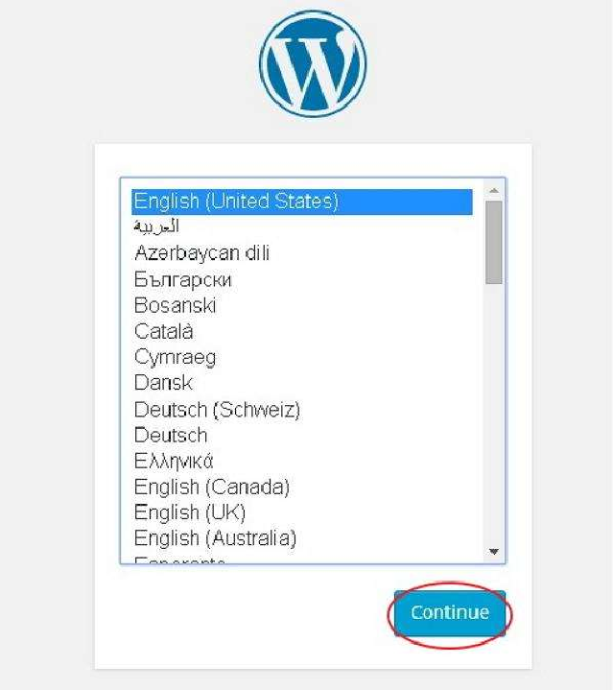


2
In our case, the path is localhost/< Your_wordpress_folder >. Select your language for the WordPress and click on Continue.
39

Slide 31
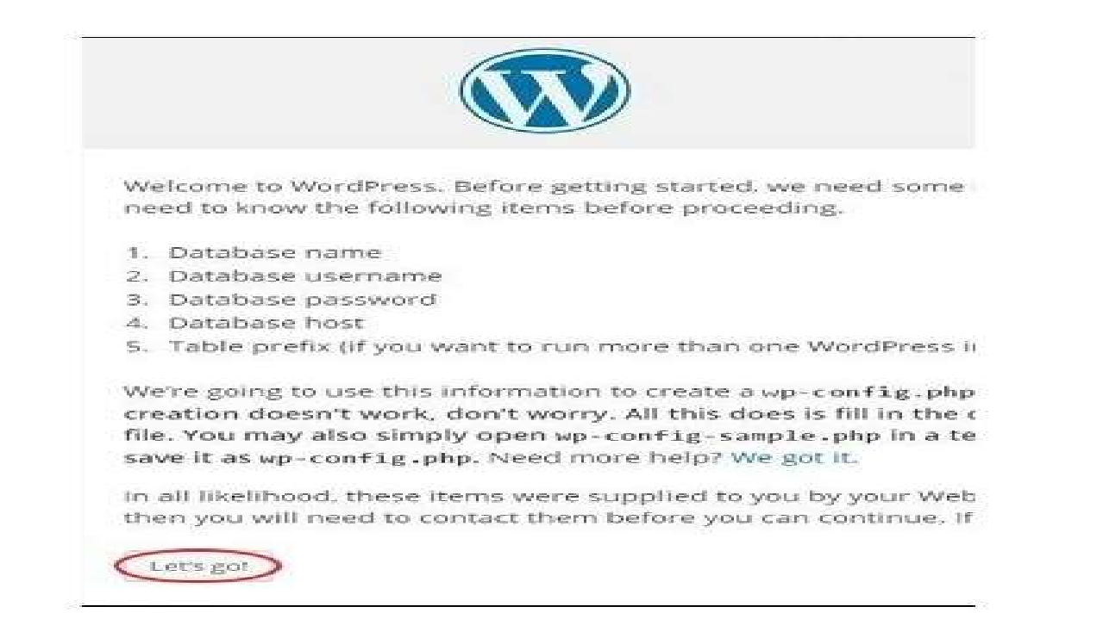

3
In this step, you can view the information needed for the database before proceeding with WordPress installation
Click on Let’s go!

Slide 32
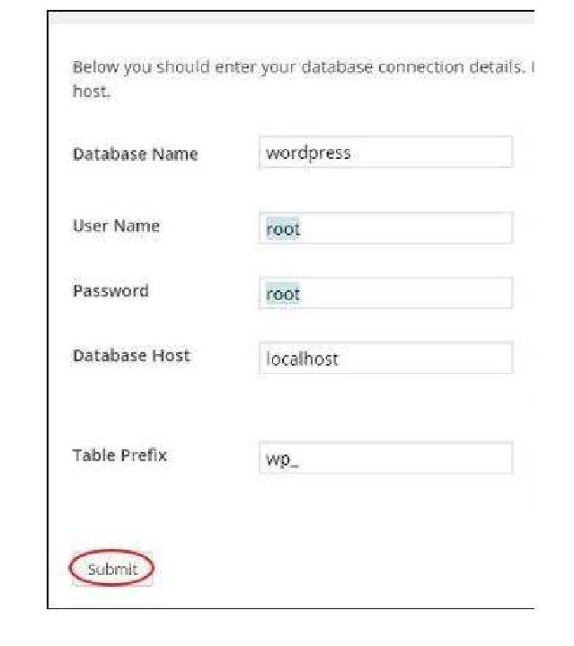

4
Here, you have to enter the information about the MySQL database as described in the following screen.
After filling all information, click on “Submit” button.

Slide 33
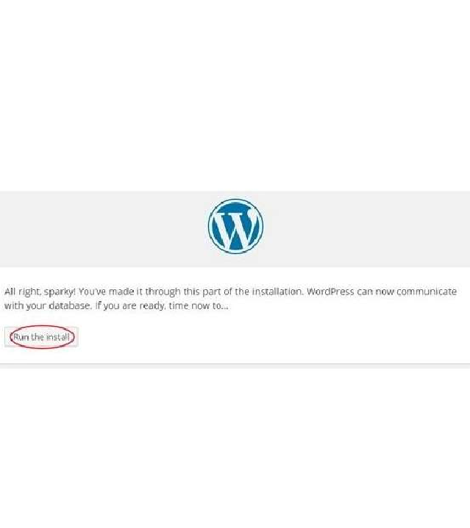

5
INSTALL
WordPress checks the database setting and gives you the confirmation screen as shown in the following snapshot.
Click on Run the Install
42

Slide 34
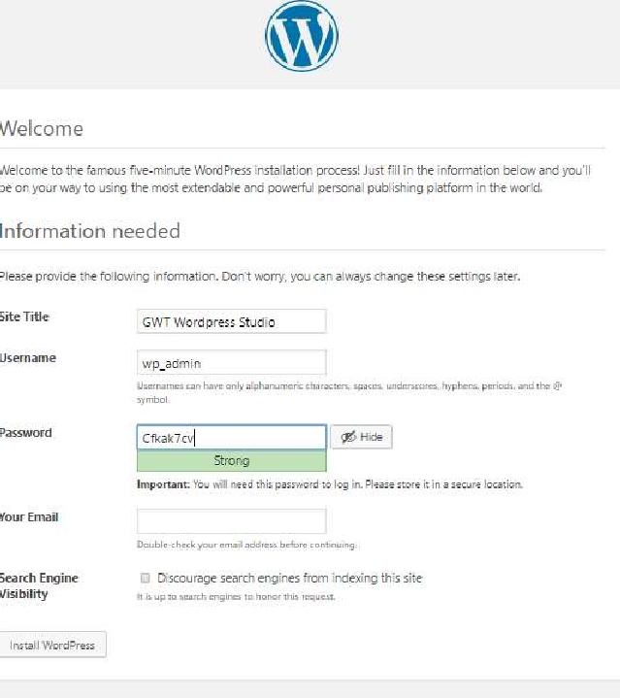

6
Enter administrative information.
After filling all information, click on “Install
WordPress” button.

Slide 35
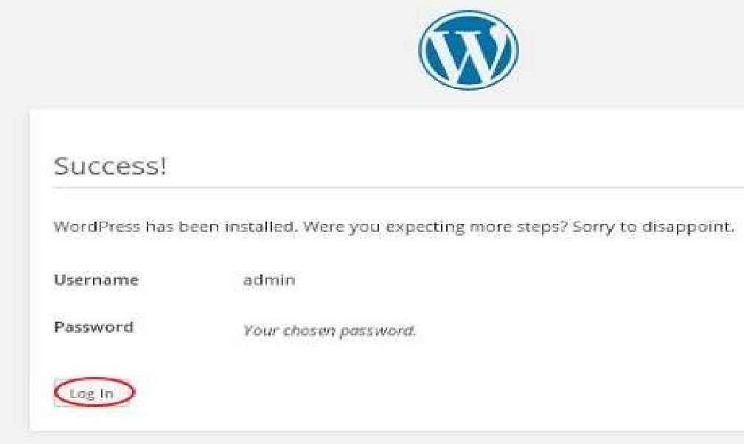


7
SUCCESS!
After installation being successful, you will get a screen of the stating success as seen in the following screen.
44

Slide 36
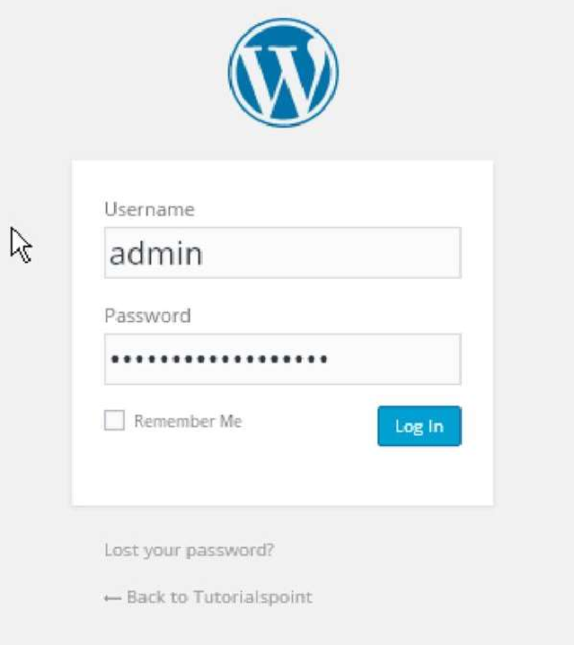

8
Enter the username and password which you had mentioned during installation as shown in step 6 and click on the Log In button.
After clicking on login, you will get a WordPress Admin Panel as depicted in the following screen.

Slide 37
CREATE YOUR WEBSITE

